Slide 1
Heat Shock Response of HSP-70 in Barley Aleurone Cells
Annie Kendzior
Andrius Dagilis
Ben Scheiner

Slide 2
Outline
Introduction
Literature
Data
Our model
Results
Conclusion

Slide 3
What is the heat shock response?
Heat shock is an exposure of a plant to extreme heat.
It causes a reaction within the plant that helps to prevent the plant from being overheated and, thus, dying.

Slide 4
Why is it important to understand the heat shock response?
development depends on secretion (germination, fertilization, fruit ripening, etc.)
defense and wounding depends on secretion
agricultural costs can be staggering

Slide 5
What are we focusing on?
barley aleurone layer
Heat Shock Protein 70
rates of secretion of HSP-70
how different temperature schemes affect the amount of HSP-70 in the cell

Slide 6
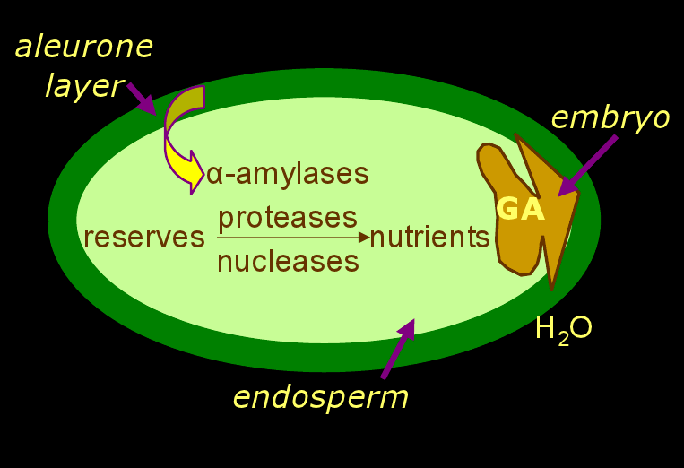
Model of a-amylase synthesis in barley aleurone cells
Notes:
GA is a growth hormone and tells the barley cell when to grow/release certain things. Alpha-amylase is not a part of our model.

Slide 7
Role of Plant HSP and molecular chaperones in abiotic stress response
Wang et al. (2004)
HSPs are responsible for protein folding, assembly, translocation and degradation.
Play a crucial role in protecting plants against stress by establishing normal protein conformation and thus cellular homeostasis.
Summarizes the significance of HSPs.
Discusses cooperation among different classes and their interactions with other stress induced components.
Five major families of HSPs/chaperones:
- HSP-70, chaperone/HSP-60, HSP-90,
HSP-100, sHSP

Slide 8
Role of Plant HSP and molecular chaperones in abiotic stress response
Wang et al. (2004)
HSP-70 is
Involved in protein import and translocation processes and in facilitating the proteolytic degradation of unstable proteins.
Involved in controlling biological activity of folded regulatory proteins and might act as negative repressors of hsf mediated transcription.

Slide 9
Surviving Heat Shock: Control Strategies for Robustness and Performance
Samad et al (2005)
Models hs and justifies their existence in terms of various performance objectives.
Also offers a modular decomposition that parallels that of traditional engineering control architecture.
Study the hsr in E-coli.
Use first order mass-action kinetics with parameters of this form:
X(t) = F(t;X;Y)
0 = G(t;X;Y),

Slide 10
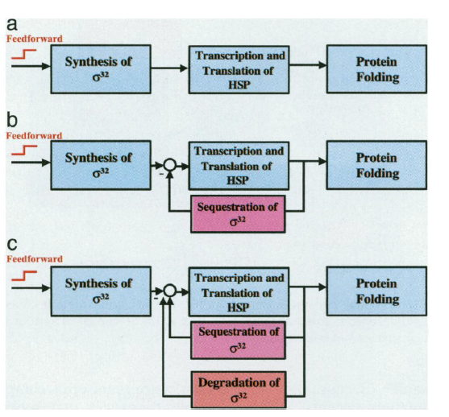
Surviving Heat Shock: Control Strategies for Robustness and Performance
Samad et al (2005)
Model attempts to analyze the methods of control of HSR, to allow for further, more robust models to be constructed.
Was very useful in building diagrams of our model system

Slide 11
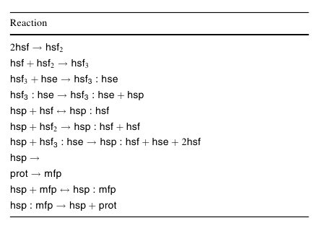
A simple mass-action model for the eukaryotic heat shock response and its mathematical validation
Petre et al. 2010
Mass action models perform well in predicting HSR in eukaryotes
Added mRNA dynamics as well as nascent protein modelling
11 reactions 33 parameters
No differentiation between HSP's
No account of recovery

Slide 12
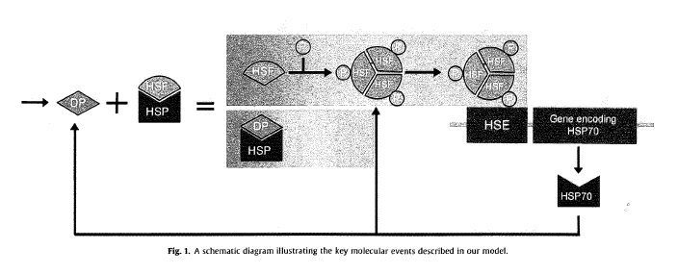
Mathematical Modeling of Heat Shock Protein Synthesis in Response to Temperature Change
Szymanska and Zylicz (2009)
models are similar to the ones we used, but theirs was about HSP70 synthesis in cancer cells
Notes:
Denatured proteins for them is a constant. It comes out of nowhere. We don't model HSE instead we go from the HSF trimer to mRNA and directly to HSP70.

Slide 13
Relevant Points for our Project
HSPs do not de-construct a-Amylase or the ER.
Two different pathways for protein synthesis during heat shock: one for HSPs, one for everything else.
Today, Dr. Brodl believes (and the literature suggests) that a central function of HSPs is to help proteins that are crumpled-up to unfold.

Slide 14
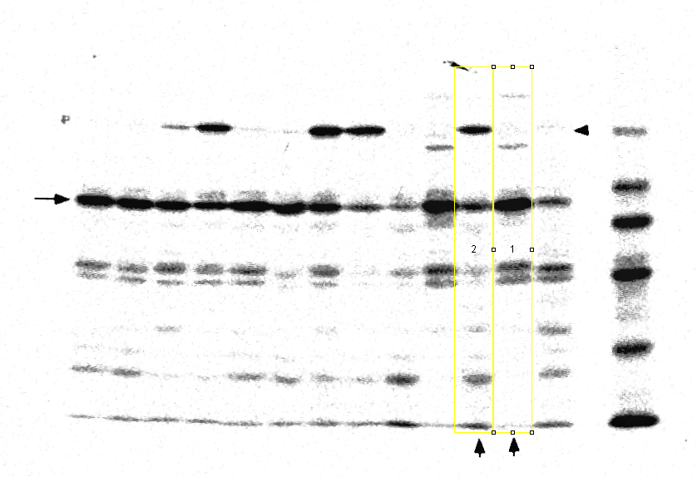
Data Extraction

Slide 15
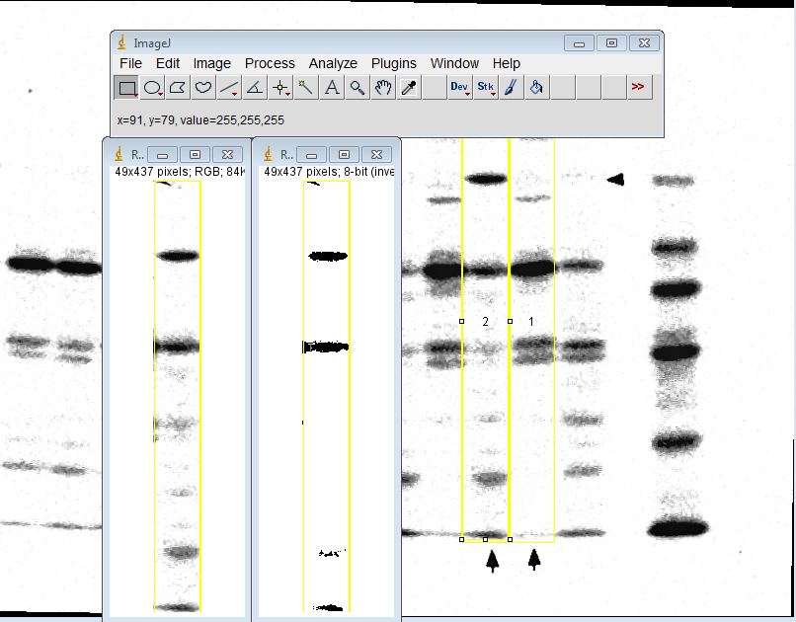
Data Extraction

Slide 16
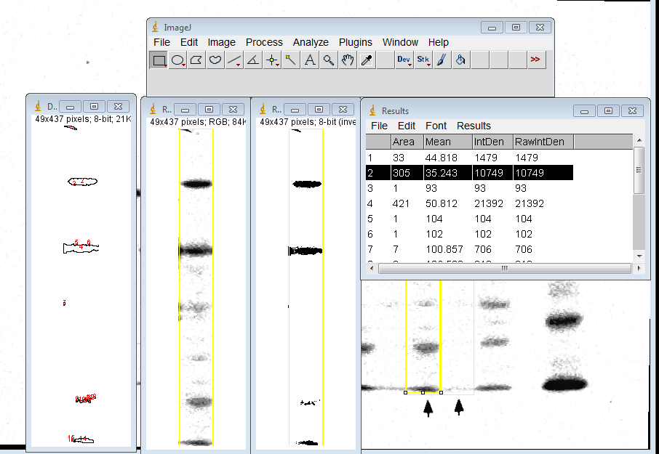
Data Extraction

Slide 17
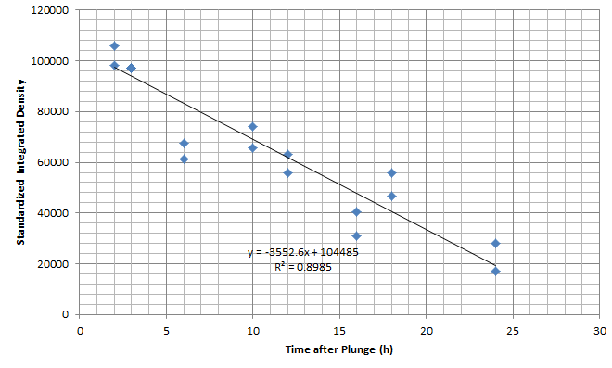
Data - plunge

Slide 18


Fast Ramp + Slow Ramp

Slide 19
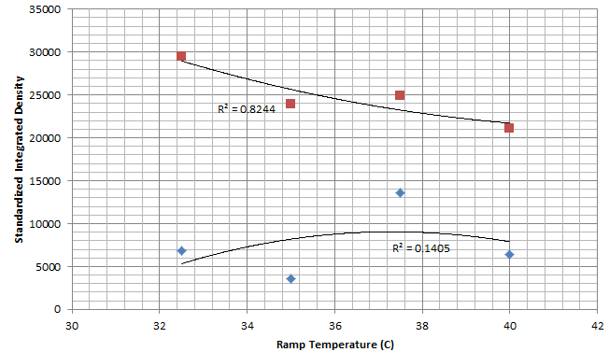
Data - Fast Ramp

Slide 20
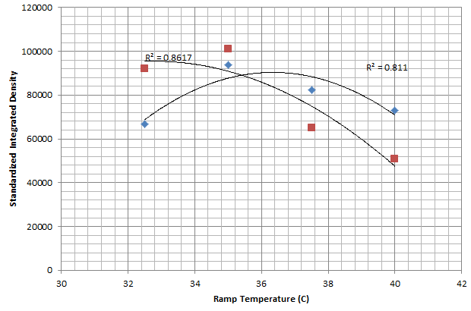
Data - Slow Ramp

Slide 21
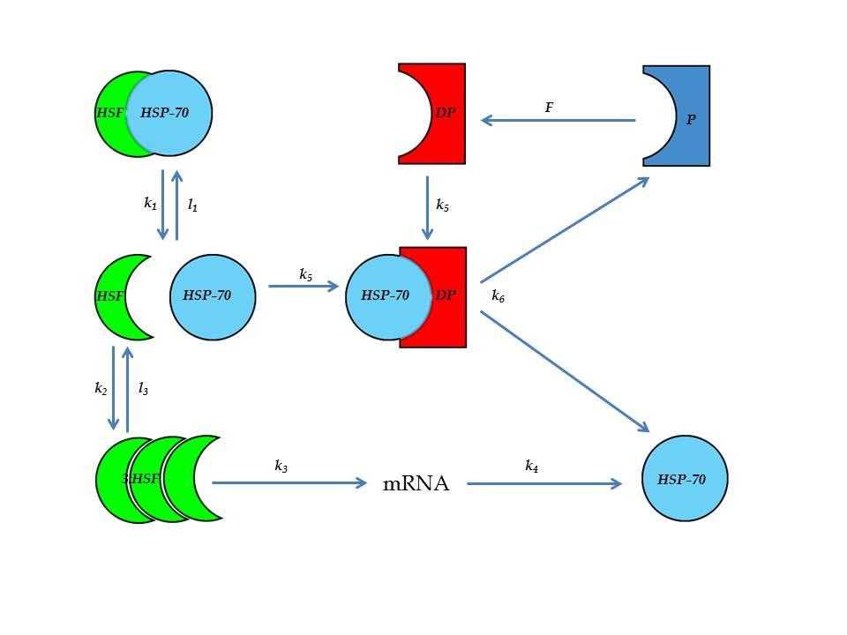
Diagram for Model

Slide 22
The Model: Definitions
x₁ is HSP-70, HSF complex
x₂ is HSP-70
x₃ is HSF
x₄ is denatured protein
x₅ is HSP-70, denatured protein complex
x₆ is protein
x₇ is HSF trimer
x₈ is mRNA

Slide 23
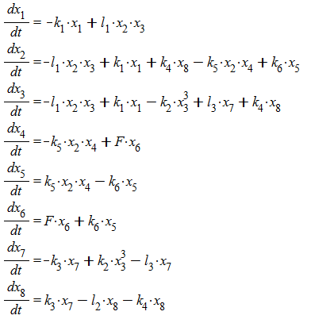
The Model: Equations

Slide 24

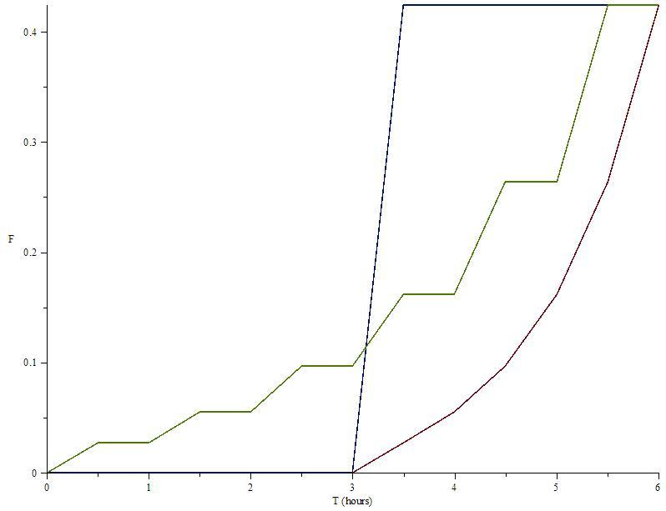
F - Effect of Temperature
modified from Szymanska et al. 2009

Slide 25
Model: Settings
Initial values are x₁ = 0.1 and x₆ = 1
All other compounds do not exist at t = 0
Parameters:
k1 = 0.005
k2 = 0.023
k3 = 0.035²
k4 = 0.035
k5 = 0.45
k6 = 0.005
l1 = 0.42
l2 = 0.035
l3 = 0.00575

Slide 26
Model: Technique
The model is a system of ODEs and some initial values
Programmed a simulation in MATLAB
Used ODE15s module
  Runge-Kutta method

Slide 27
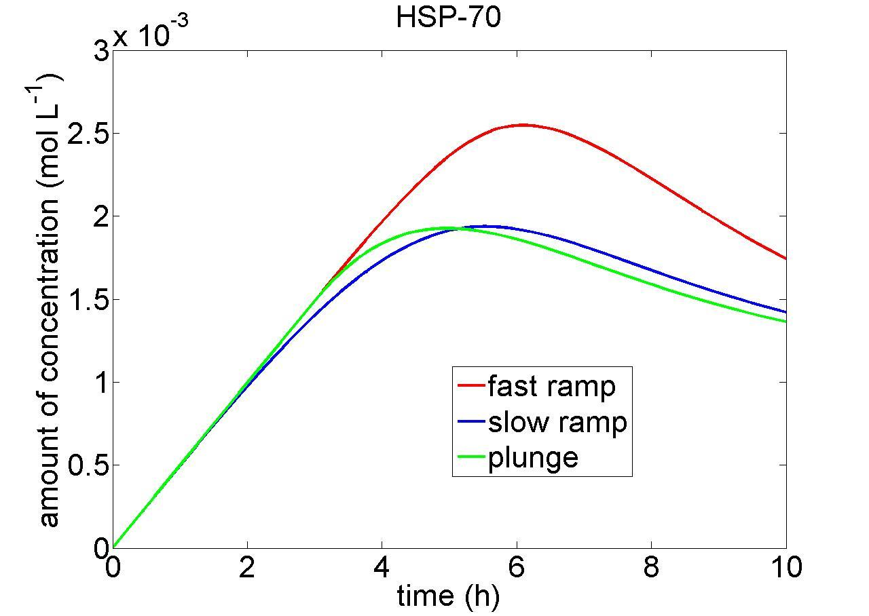

Slide 28
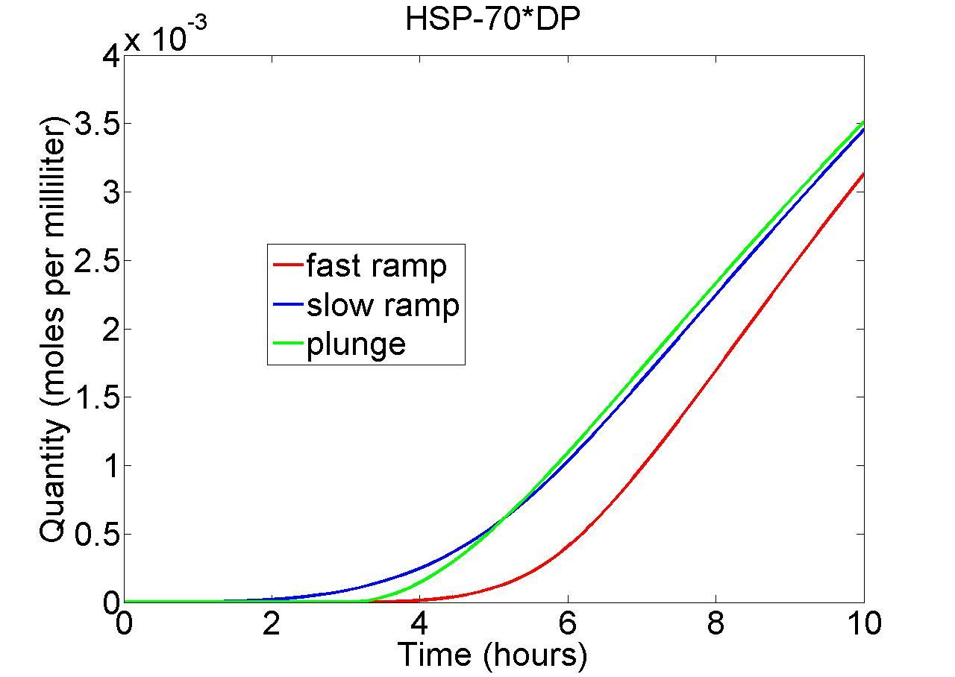

Slide 29
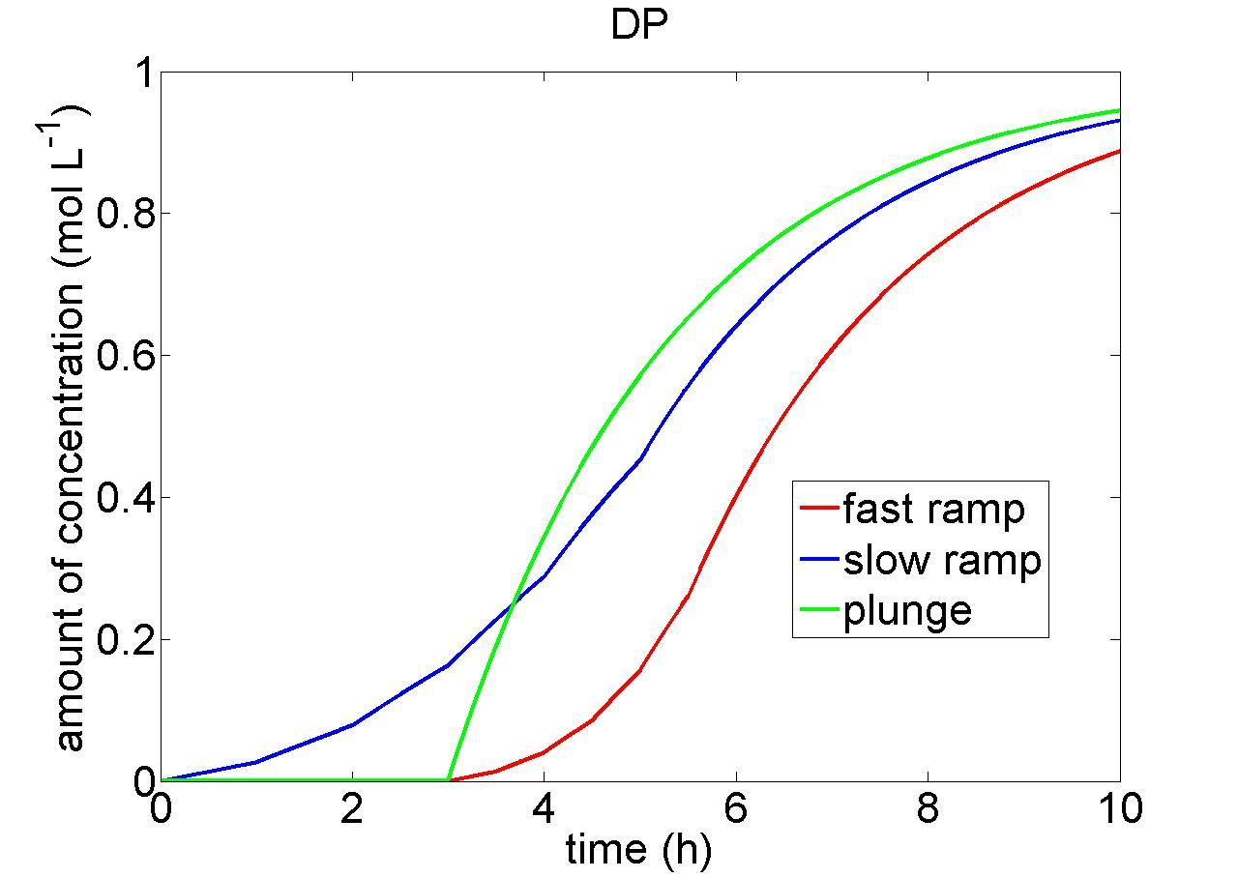

Slide 30
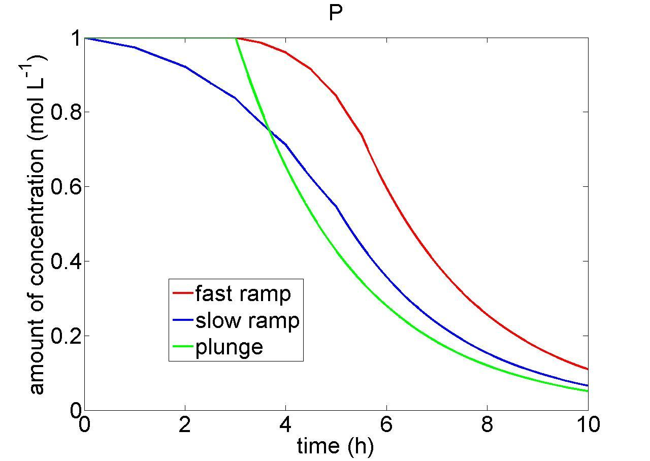

Slide 31
Conclusions: What's left
Need to correct initial values
Steady state analysis of model
More/better data for validation

Slide 32
Thank you for listening.
Any Questions?

