Slide 1
Presidential Election Model 2012
Christopher P. Alexander
Ethan J. Krohn
Selman Kaldiroglu
Vanessa Moreno

Slide 2
Outline
Introduction
Data Collection - Methodology
Problems
Results
Looking Forward

Slide 3
What Are We Modeling?
We will model the outcome of the 2012 presidential election between Barack Obama and Mitt Romney in certain states.
We selected various states in order to have a diverse sample on which to build our model.
We wanted to use certain demographics and see using only these demographics whether we can predict the actual results.

Slide 4
Goals
Find a method of prediction that is consistent for all states that we have collected data for.
See how certain demographics play a role in determining the outcome of the election.
(Later) Develop a model of how Blue or Red a state is over time in relation to its population demographics.

Slide 5
Original Model
Pro-Obama
Susceptible
Pro-Romney
First, we focused on modeling the changes of each group over time, the groups being: Pro-Obama, Pro-Romney, and Susceptible. This preliminary model was based on a report named A Mathematical Model of Political Affiliations.
Ex:

Slide 6
Modified Model
The old model had various problems
We switched away from the dynamic system because our data was not based on the movements of groups, but rather the current moods of sampled individuals.
Thus, we decided to use various regression models to estimate the importance of demographics and forecast the outcome.

Slide 7
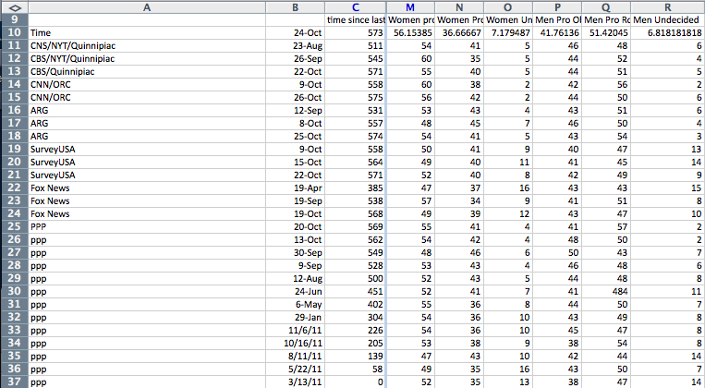
Ohio: Gender

Slide 8
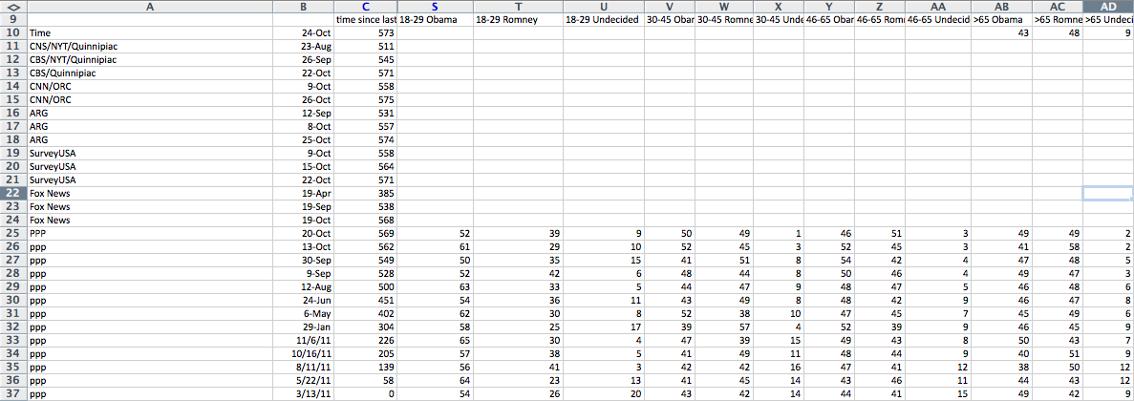
Ohio: Age

Slide 9
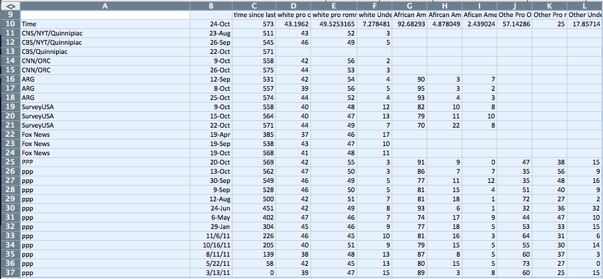
Ohio: Race

Slide 10
Results
Ran different order regressions on the data. Specifically we ran from order 1 to 10.
We adjusted the predicted results and actual results to only include people who voted, i.e.
We picked the closest order to the actual results and checked for consistency in other states.

Slide 11
Combined Adjusted Results

Slide 12
Ohio: Results
Order of Regression | Obama | Romney
Reality (adjusted) | 51 | 49
1 | 52.4 | 47.6
2 | 52.24 | 47.76
3 | 51.95 | 48.05
4 | 52.39 | 47.61
5 | 52.46 | 47.54
6 | 51.89 | 48.11
7 | 52.6 | 47.4
8 | 53.08 | 46.92
9 | 53.31 | 46.62
10 | 56.92 | 43.08

Slide 13
Ohio: Model Prediction

Slide 14
Georgia: Results
Order of Regression | Obama | Romney
Reality (adjusted) | 46.05 | 53.95
1 | 43.84 | 56.16
2 | 44.7 | 55.3
3 | 43.84 | 56.16
4 | 43.41 | 56.59
5 | 41.37 | 58.63
6 | 39.34 | 60.66
7 | 41.05 | 58.95
8 | 38.46 | 61.54
9 | 46.33 | 53.67
10 | 39.96 | 60.04

Slide 15
Georgia: Model Prediction

Slide 16
Georgia: Model Prediction (zoom)

Slide 17
Florida: Results
Order of Regression | Obama | Romney
Reality (adjusted) | 50.45 | 49.55
1 | 50.09 | 49.91
2 | 49.87 | 50.13
3 | 49.46 | 50.54
4 | 49.24 | 50.76
5 | 49.31 | 50.69
6 | 49.37 | 50.63
7 | 48.41 | 51.59
8 | 48.08 | 51.92
9 | 48.22 | 51.78
10 | 49.29 | 50.81

Slide 18
Florida: Model Prediction

Slide 19
Pennsylvania: Results
Order of Regression | Obama | Romney
Reality (adjusted) | 52.53 | 47.47
1 | 53.42 | 46.58
2 | 53.89 | 46.11
3 | 52.56 | 47.44
4 | 51.75 | 48.25
5 | 51.32 | 48.68
6 | 51.75 | 48.25
7 | 51.57 | 48.43
8 | 52.2 | 47.80
9 | 52.48 | 47.52
10 | -0.01% | 100.01%...

Slide 20
Penn: Model Prediction

Slide 21
North Carolina: Results
Order of Regression | Obama | Romney
Reality (adjusted) | 48.94 | 51.06
1 | 49.51 | 50.49
2 | 49.51 | 50.49
3 | 49.34 | 50.66
4 | 49.13 | 50.87
5 | 49.66 | 50.34
6 | 49.90 | 50.10
7 | 49.90 | 50.10
8 | 49.90 | 50.10
9 | 50.45 | 49.55
10 | 51.20 | 48.80

Slide 22
North Carolina: Model Prediction

Slide 23
Analysis
Results:
OH: Order: 6 Error Margin: 0.89% (2nd Best Order: 3)
FL: Order: 1 Error Margin: 0.36% (2nd Best Order: 2)
GA: Order: 9 Error Margin: 0.28% (2nd Best Order: 2)
PA: Order: 3 Error Margin: 0.03% (2nd Best Order: 9)
NC: Order 4 Error Margin: 0.20% (2nd Best Order: 3)
This inconsistency in Order of Polynomials indicates that there may be no best fit polynomial for predicting the election

Slide 24
Analysis
Indeed, we considered the polynomials of degree 9 and degree 3
We looked at different states and compared the variance of the regression model.

Slide 25
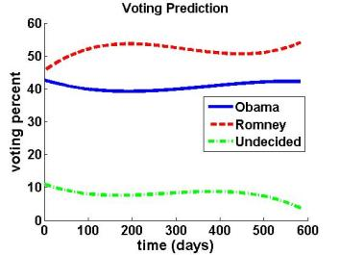
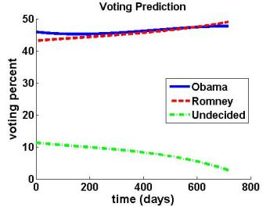
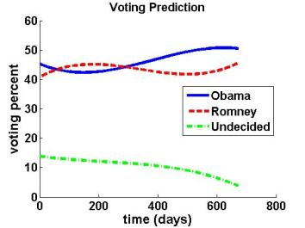
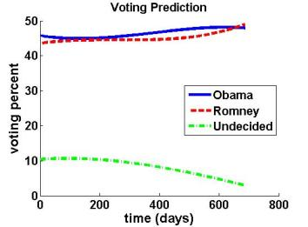
Degree 3

Slide 26
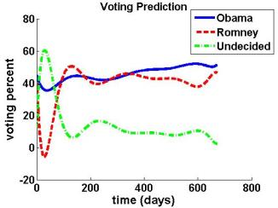
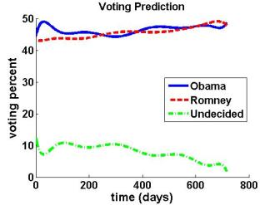
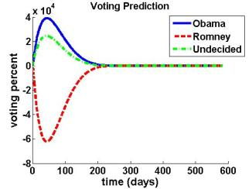
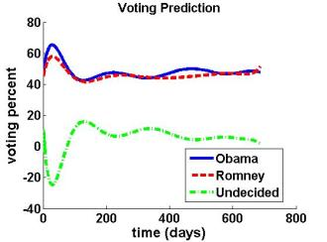
Degree 9

Slide 27
Analysis
We can qualitatively see that the degree 9 polynomials don’t look right.
That is, they have unrealistic looking paths.
However, the degree 3 looks neater and more reasonable.

Slide 28
Startling Results
We should consider how well the polynomial does on average
Something can be the best predictor a couple times, and be terrible the rest of the time
The Third Degree Polynomial predicts well on average!

Slide 29
Concerns
We weighted our demographic information by 2008 voting behavior.
This does not take into consideration population change.
Nor does it consider voter enthusiasm or cultural changes.
The non-availability and inconsistency in data makes it very difficult to accurately predict the election or conclude that there is something special about the degree 3 polynomial.

Slide 30
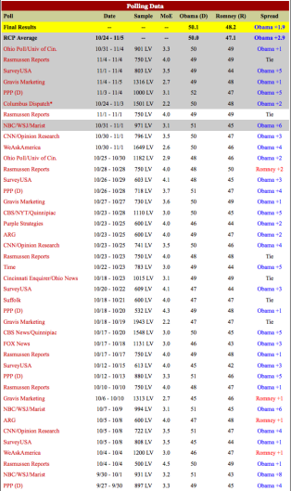
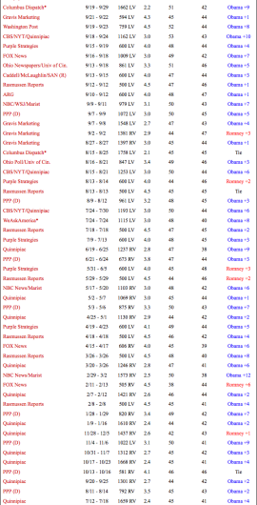
Ohio Data Availability

Slide 31
Georgia Data Availability

Slide 32
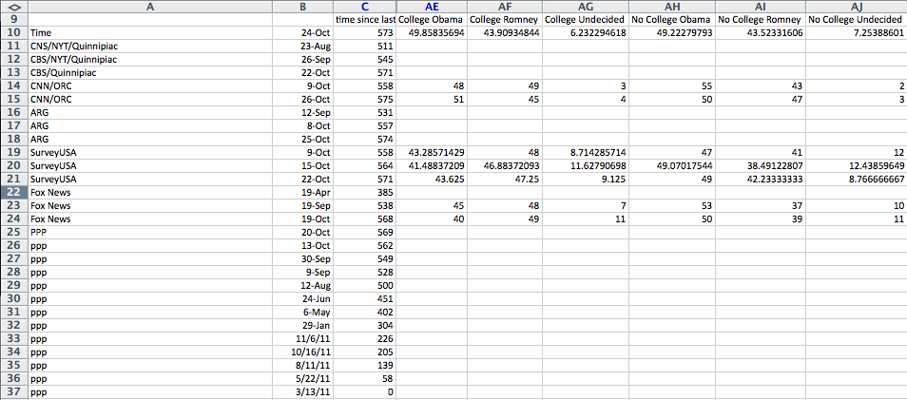
Concerns
Data Collection related problems:

Slide 33
“Cutoff” Problem
Income and maybe Age but figured it out.

Slide 34
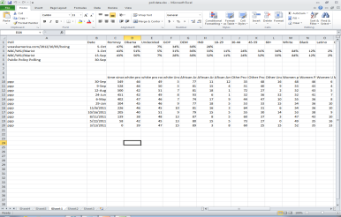
Multiple Companies?
Pros
By using more than one polling company we are eliminating possible bias certain companies may have.
Cons
Due to the differences in methodology in the polling companies, we have discrepancies in the number of observations, therefore have a high error variance.

Slide 35
Ex: African American Undecided

Slide 36
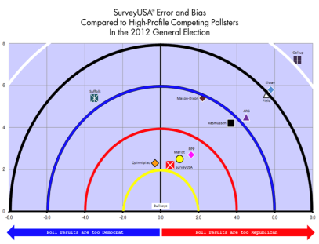
Biased Polling
Perhaps our largest issue
Politics is inherently political
Many of the available polls have political allegiances (PPP, Fox News)

Slide 37
Plans for Spring 2013
We all are really interested in continuing with the research.
We want to see if there really is statistically significant reason why degree 3 polynomials work.
Study more states.
Dr. Suárez brought up the possibility of using similar techniques to develop a metric for how blue or red a state is.
We could model how changing population demographics and voting behaviors move together.
Issues: we need accurate census data on particularly the Hispanic and Latino populations and voting behaviors of these populations.

Slide 38
Bibliography
Rasmussen Reports, LLC. Pulse Opinion Research. Survey. May, 2011 - November, 2012.
Gravis Marketing, Inc. Florida. Survey. June, 2011 - November, 2012
Public Policy Polling. Raleigh, North Carolina. Survey. March, 2011 - November, 2012
University of Cincinnati. The Ohio Poll. Survey. January, 2012 - November, 2012.
SurveyUSA. Survey. October, 2011 - November, 2012.
Fox News Poll. Anderson Robbins Research. Survey. October, 2011 - November, 2012.
The Huffington Post. Huffpost Politics: Election Resulst. September, 2012- November, 2012.
The Purple Strategies. PurplePoll. September, 2012- November, 2012
American Research Group. Survey. September, 2012- November, 2012
Cable News Network. CNN/ORC Poll. October, 2012- November 2012

Slide 39
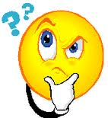
Thank You For Listening!
Special thanks to
Dr. Dante Suárez
Dr. Eddy Kwessi
Especially to
Dr. Hoa Nguyen!!!

