Slide 1
Understanding Alzheimer’s Disease Volume Perturbation Analysis using Molecular Dynamics Simulations
Santona Tuli
Garner Cochran
Hai Viet Duong
Austin Workman

Slide 2
Alzheimer’s Disease
Protein misfolding disease
Accumulation of abnormally folded beta- and tau-amyloid proteins
Details:
Neurons are surrounded by a plasma membrane consisting of a bilayer of lipid molecules with protein structures embedded in it
Transmembrane proteins penetrate though the neuron membrane
APP is a transmembrane protein critical to neuron growth and repair

Slide 3
Alzheimer’s Disease
An unknown process causes the APP to divide into smaller portions, one of which is beta-amyloids
Fibrils of beta-amyloids clump together outside neurons and form senile plaques

Slide 4
Outline of Project
Goal: To understand the process through which APP (a trans-membrane protein) is divided into fragments including abnormally folded beta-amyloid (i.e. protein misfolding) which accumulate to form senile plaques (which is the initial stages of Alzheimer's disease).
Method: We produce Molecular Dynamics simulations of protein-lipid interactions at the site of protein misfolding, then analyze the volume perturbation of all molecules due to the protein insertion.

Slide 5
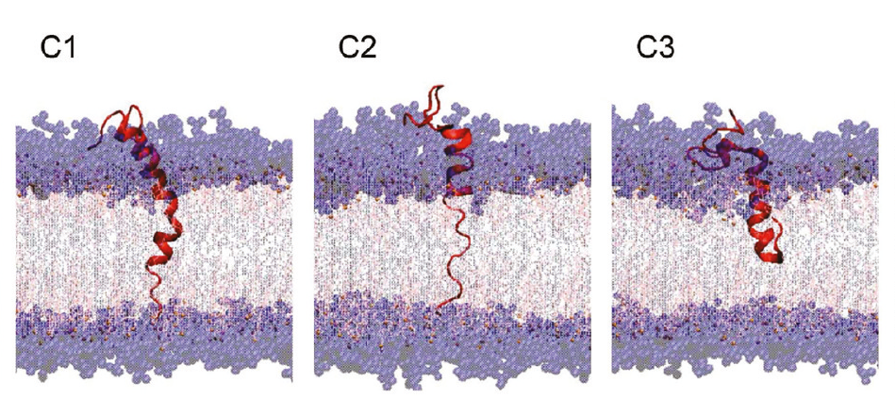
Simulations
The simulations to give us the numbers and positions of the molecules involved whenever proteins and lipids interact to potentially cause misfolding of beta-amyloids
Box containing all the relevant molecules (Lipids, proteins, water, cholesterol)
Molecule-molecule interactions: Vander Waal’s forces, dipole interactions, biochemical interactions at the interfaces
Other factors: Atomic size weighting

Slide 6
Breakdown of Simulation Stages
Generating the appropriate region:
Lipids in the annular region
Using Surround
Using Voro++
Adding water and cholesterol
Computing distances and generating volumes
Generating volume perturbation plots

Slide 7
Surround
Program in C
Takes a PDB, outputs a PDB
Outputs only the molecules within the ‘annular’ region of protein molecules
We are interested in annular lipids
Annular lipid molecules to annular lipids (50% cut off)
Parameters: Radius of annular region, cut off percentage – Arbitrary..?

Slide 8
Voronoi Tessalation
Virtual Molecular Dynamics: Voro++
Mathematics – Perpendicular bisectors used to define area or volume
We perform VT in 3 dimensions
3D distribution of protein and lipid molecules
Same results as Surround, but with a visual display

Slide 9
Results from Surround
ASP1 ALA2 GLU3 PHE4 ARG5 HIS6 ASP7 SER8 GLY9 TYR10 GLU11 VAL12 HIS13 HIS14 GLN15 LYS16 LEU17 VAL18 PHE19 PHE20 ALA21 GLU22 ASP23 VAL24 GLY25 SER26 ASN27 LYS28 GLY29 ALA30 ILE31 ILE32 GLY33 LEU34 MET35 VAL36 GLY37 GLY38 VAL39 VAL40 POP71 POP165 POP168 POP192 POP200 POP522 POP523 POP526 POP544 POP548 POP552 POP588 POP590 POP638 POP640 POP643 POP663 POP664 POP667 POP672 POP675 POP676 POP678 POP762 POP764 POP765 POP789 POP792 POP795 POP797 POP921

Slide 10
Results from Voro++
ASP1 ALA2 GLU3 PHE4 ARG5 HIS6 ASP7 SER8 GLY9 TYR10 GLU11 VAL12 HIS13 HIS14 GLN15 LYS16 LEU17 VAL18 PHE19 PHE20 ALA21 GLU22 ASP23 VAL24 GLY25 SER26 ASN27 LYS28 GLY29 ALA30 ILE31 ILE32 GLY33 LEU34 MET35 VAL36 GLY37 GLY38 VAL39 VAL40 POP41 POP46 POP52 POP59 POP63 POP65 POP67 POP68 POP71 POP96 POP111 POP168 POP192 POP200 POP288 POP289 POP292 POP293 POP298 POP316 POP322 POP323 POP329 POP330 POP337 POP521 POP522 POP523 POP526 POP542 POP544 POP545 POP548 POP552 POP557 POP570 POP573 POP579 POP580 POP582 POP585 POP586 POP587 POP588 POP590 POP638 POP640 POP663 POP667 POP672 POP675 POP676 POP678 POP762 POP764 POP765 POP767 POP776 POP789 POP792 POP793 POP794 POP795 POP797 POP798 POP799 POP802 POP806 POP807 POP809 POP811 POP818 POP820 POP827 POP921

Slide 11
Comparing the Simulations
These results are very similar. Almost all of the “annular lipids” from surround are contained in those from the Voro++ simulation
The Voro++ simulation contains more of these “annular lipids”
No mathematical deduction of comparative accuracy, rather we can use physical understanding of the interactions and knowledge of simulation techniques and shortcomings to determine accuracy
Cross check
Proceed with Voro++

Slide 12
Data Analysis
Goal:
Volume perturbation of lipid molecules due to proteins
Range of perturbations
Volume vs. Distance
Method:
Defining distance
Volume generation (using Voro++)

Slide 13
Ideas for Measuring Distances
We have two ways currently of measuring distances:
Average atomistic distance:
For each atom in a given molecule, determine the atom of the protein closest to it, and compute this distance.
Next, find the average of these distances for all the atoms in the given molecule
Nth neighborhood distance
Idea for future work
Potential problems

Slide 14
Volume Perturbation of Lipid Molecules

Slide 15
Volume Perturbation of Cholesterol Molecules

Slide 16
Volume Perturbation of Water Molecules

Slide 17
Analysis of Volume Perturbation Profiles
Lipids and Cholesterol:
We notice that the volumes of the lipid and protein molecules are constrained for smaller distances, and
Water: Since we have so many water molecules it is hard to determine a trend from these molecules.

Slide 18
Future Work
Project will continue next semester
Incorporate Atomic weighting in volume generation
Consider other definitions of distance
First generation and second generation neighbors

Slide 19
Bibliography
Mori, Takaharu, Fumiku Ogushi, and Yuji Sugita. "Analysis of Lipid Surface Area in Protein-Membrane Systems Combining Voronoi Tessellation and Monte Carlo Integration Methods." Journal of Computational Chemisty (2011): n. pag. Web. 3 Dec. 2012.
Goodsell, David. "Understanding PDB Data: Looking at Structures." RCSB PDB-101. WwPDB, n.d. Web. 03 Dec. 2012. <http://www.rcsb.org/pdb/101/static101.do?p=education_discussion/Looking-at-Structures/intro.html>.
Vanden-Eijnden, Eric, and Maddalena Venturoli. "Markovian Milestoning with Voronoi Tesselations." The Journal Chemical Physics (2009): n. pag. Jcp.aip.org. American Institute of Physics, 2009. Web. 3 Dec. 2012.
Qui, Liming, Creighton Buie, Andrew Reay, Mark Vaughn, and Kwan Cheng. "Molecular Dynamics Simulations REveal the Protective Role of Cholestrol in B-Amyloid Protein-Induced Membrane Disruptions in Neuronal Membrane Mimics." The Journal Chemical Physics (2011): n. pag. Pubs.acs.org/JPCB. Department of Physics and Engineering at Texas Tech. Web. 3 Dec. 2012.
Benjamin, Bouvier, Raik Grunberg, Michael Nigles, and Frederic Cazals. "Shelling the Voronoi Interface of Protein-protein Complexes Reveals Patterns of Residue Conservation, Dynamics, and Composition." Proteins: Structure, Function, Bioinformatics (2010): n. pag. Institut De Biologie Et De Chimie Des Proteines. Web. 3 Dec. 2012.

Slide 20
Thank You
Dr. Nguyen
Dr. Cheng

