Slide 1
Diffusion-Limited Evaporation Model and Analysis
Joe Chen and Daniel Villamizar

Slide 2
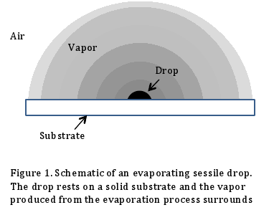
Problem Statement
Diffusion-Limited Evaporation Model
Evaporation by other means neglected for sessile water drops
Need to develop steady state approximation
Simplify with flat disk model, then move to sphere.
Weber’s Disk approx.

Slide 3
Motivation
For Project:
Important learning in Physics
DNA stretching and depositing, self-assembly and patterning
Nanowire fabrication
Many other important applications
For us:
Develop and experiment with our Numerical Analysis skills
Discover an important real life application for these methods

Slide 4
Overview
PDE
Boundary Conditions (Weber’s)
Domain
∞
z
0
a
r
∞
∞
Finite

Slide 5
Overview
Simplifying the Laplacian = 0
Infinite Boundary → Hankel Transform
= 0
In our case:
ρ → r
Φ → θ
f → C

Slide 6
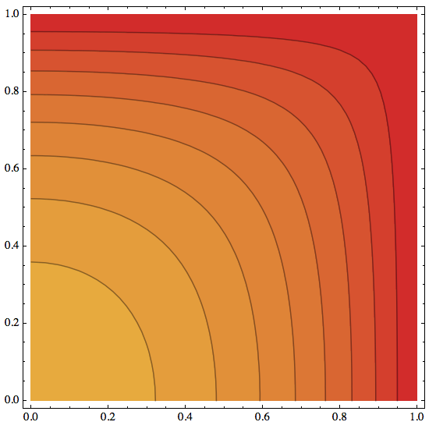
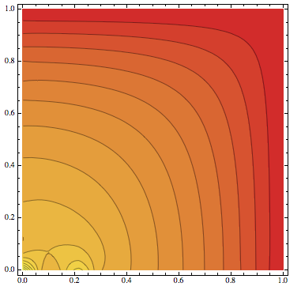
Methods
Failed Methods:
Elmer
Maple
Only in the form:
Mathematica
No real support for mixed BC

Slide 7
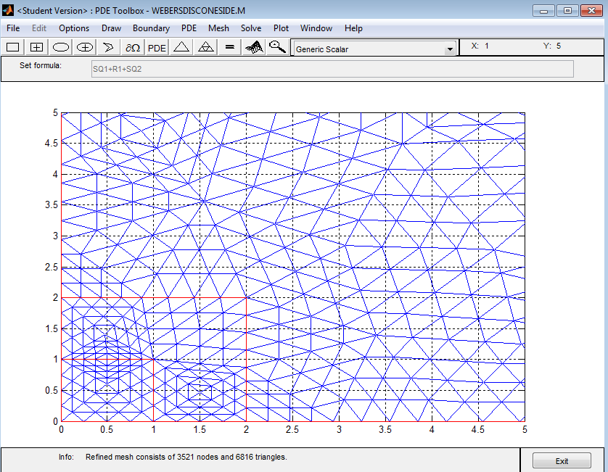
Methods
Successful Methods:
MATLAB
PDE Toolbox
Accepted BCs
Nice models

Slide 8
Results (Weber’s Disc)

Slide 9
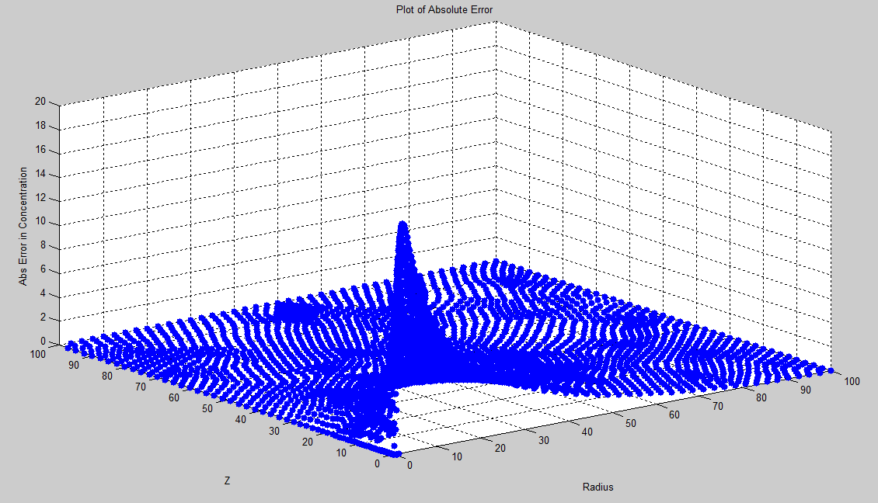
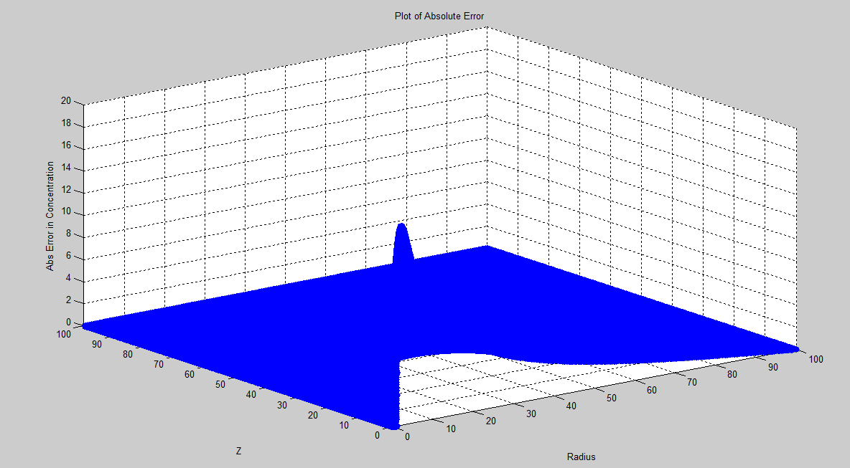
Weber’s Disc Error
3521 Points
219009 Points
Max Absolute Error: 19.1605 (r=1.875,Z=0.1168)
Average Absolute Error: 2.1341
R2 Error: 0.0740
Max Absolute Error: 18.0554 (r=2.0978,Z=0)
Average Absolute Error: 2.4254
R2 Error: 0.0093

Slide 10
Change of Variables
C_{new} = C_{o-}C_{old}
PDE stays the same
Boundary Conditions & Solution Changes
C_{new}(r<=a,z=0) = C_{o}
C_{new}(r>a,z=0) = dC_{new}/dz=0
C_{new}(r=∞,z) = 0
C_{new}(r,z=∞) = 0

Slide 11
Change of Variables Solution

Slide 12
Change of Variables Error
3521 Points
Max Absolute Error: 18.9823 (r=2,Z=0)
Average Absolute Error: 2.1386
R2 Error: 0.0743

Slide 13
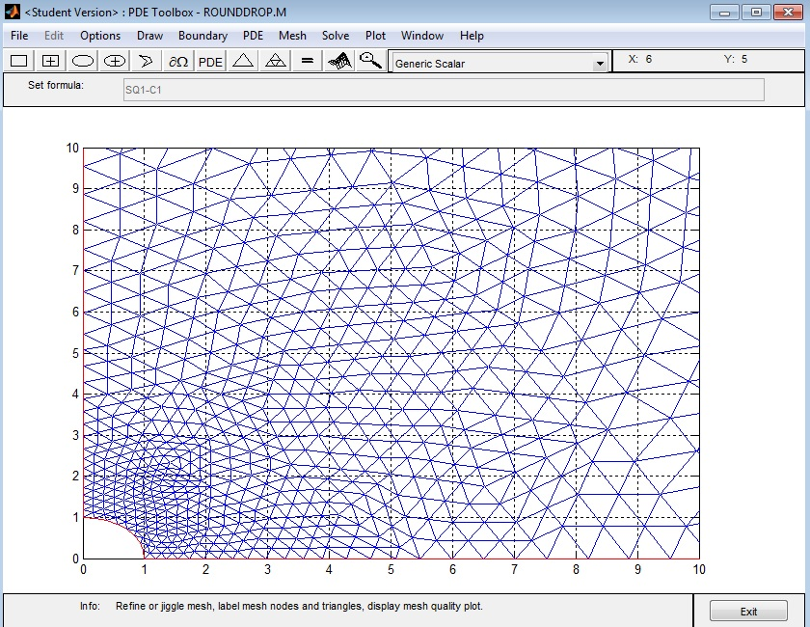
Round Drop Solution

Slide 14
Round Drop Solution

Slide 15
Research Extension
Use infinite domain
Explore other software
Finite Difference
Include model of other transport processes (convection)

