Slide 1
Analyzing Structures and Dynamics
of Protein/Lipid Interactions Using Voronoi Tessellation Methods
Valeri Alexiev, Jeanna Balreira
and Vanessa Moreno
Numerical Analysis 3351
FINAL PRESENTATION - MAY 3, 2013

Slide 2
Outline
Motivation
Project Overview
Methods
Results
Further Research
References

Slide 3
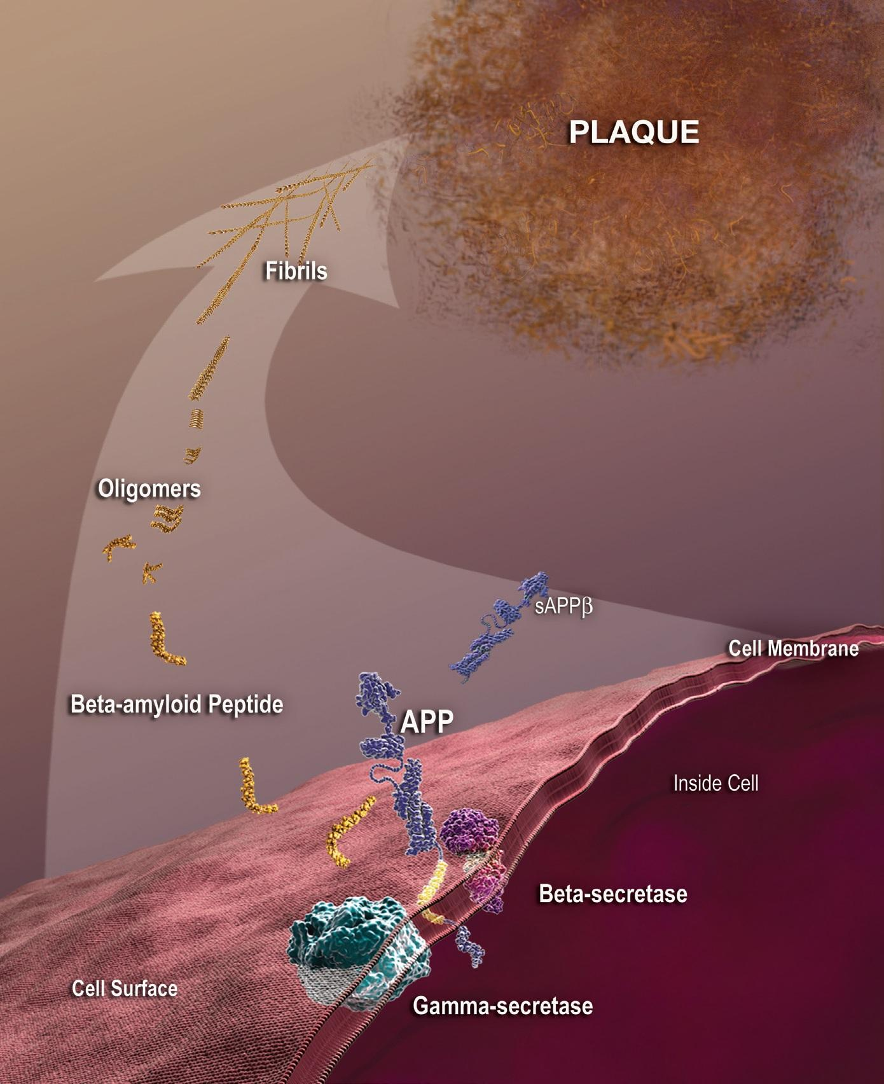
Motivation
The misfolding of proteins and their aggregations has been linked to cause diseases.
The surface area, volume, and voids of molecules help characterize the protein misfolding and aggregation on cell membranes.
Conformal annular lipids surround a protein, this leads to miscalculations for these parameters using traditional methods

Slide 4
Project Overview
In order to better understand why some protein misfolding form harmful plaques...
Develop Voronoi tessellation methods to calculate surface area and the volume of different functional groups of lipid and protein molecules.
Determine if and how void spaces can be calculated in these lipid and protein groups.

Slide 5
Methods
To understand the VT methods used in Voro++ and Voroprot, we:
Created our own VT in Matlab
Given:
  A 2D plane setting
  Generator 1
    x1=(.25, .25) ; w1= .25
  Generator 2
    x2=(.75, .75) ; w2=.50
Calculated the Power VT (Voro++) and Additively Weighted VT (Voroprot).

Slide 6
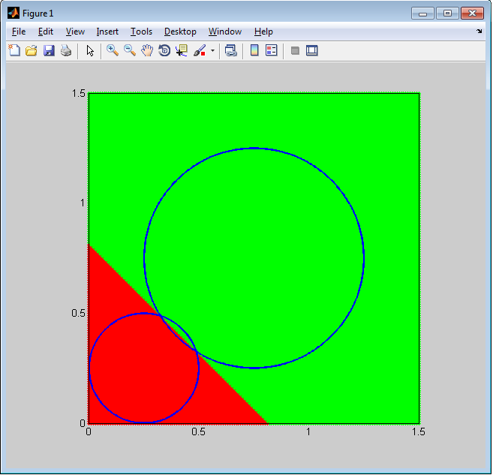
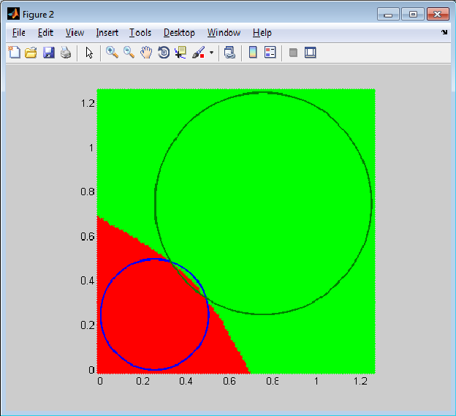
Methods - 2 generators
Power VT for the two generators using our Matlab script
Weighted VT for the two generators using our Matlab script

Slide 7
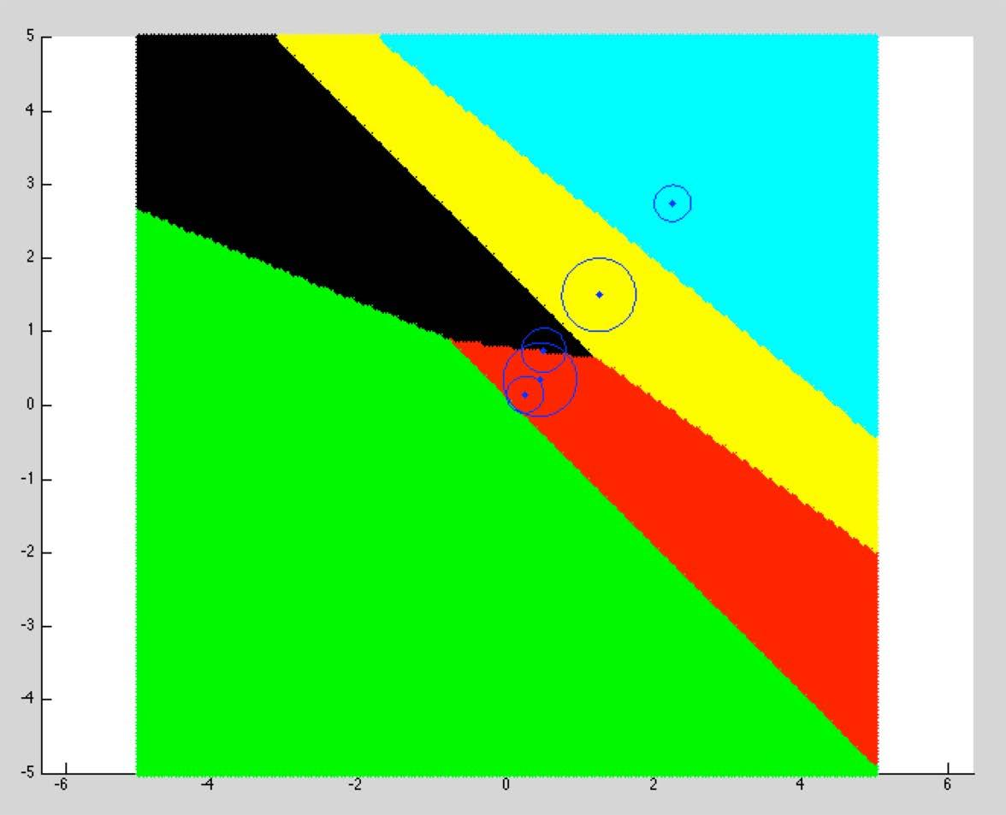
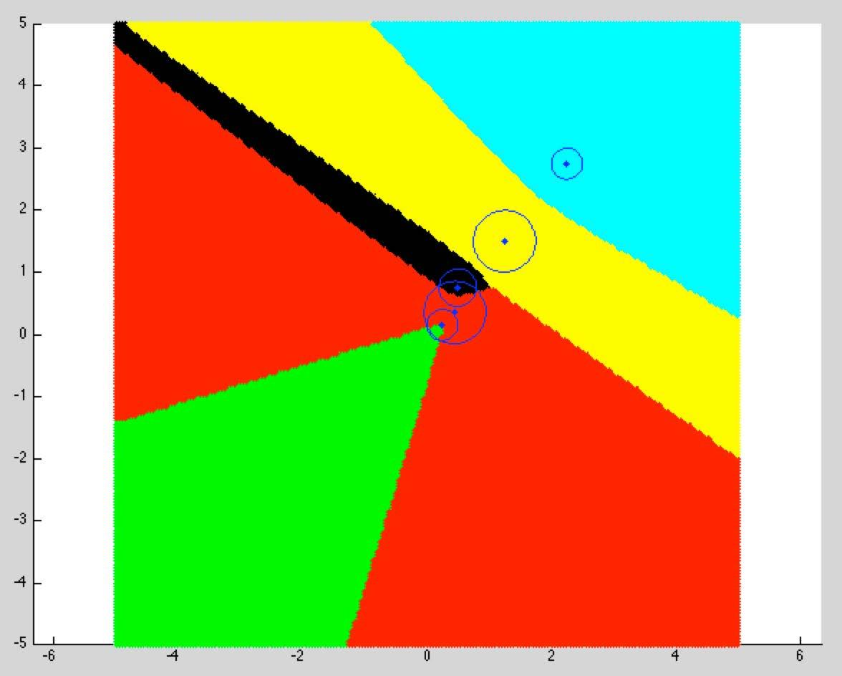
Methods - 'N' generators
Points Used: [ (.15, .15), .25 ; (.35,.35),.5; (.5,.5), .3; (1.15,1.15, ), .5; (2.75,2.25) ,.25]
Power VT for 'N=5' generators using our Matlab script
Weighted VT for 'N=5' generators using our Matlab script

Slide 8
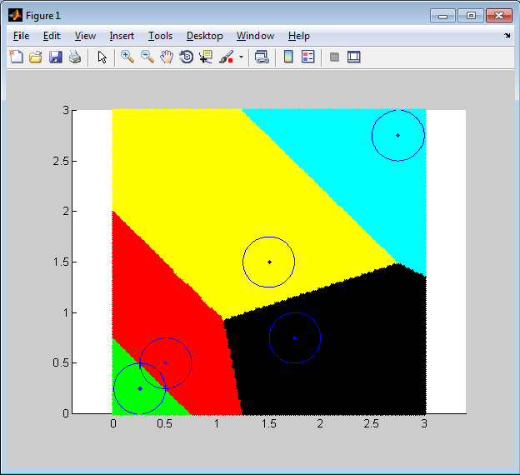
Methods-
Checking Accuracy of Algorithms
Modified our Matlab code
Changed the Power/Additively Weighted distance to Euclidian distance
Assigned weight of .25 to all of our points.
Points Used:
  (.25,.25), (.50,.50), (1.75,.75) (1.5,1.5), (2.75,2.5).

Slide 9
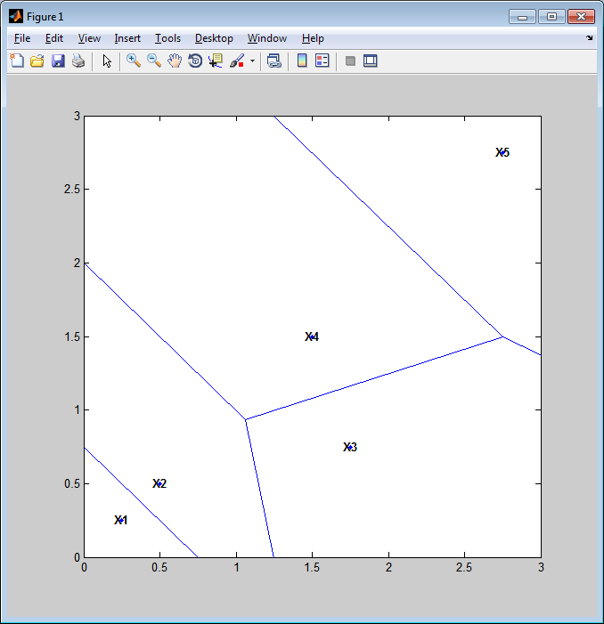
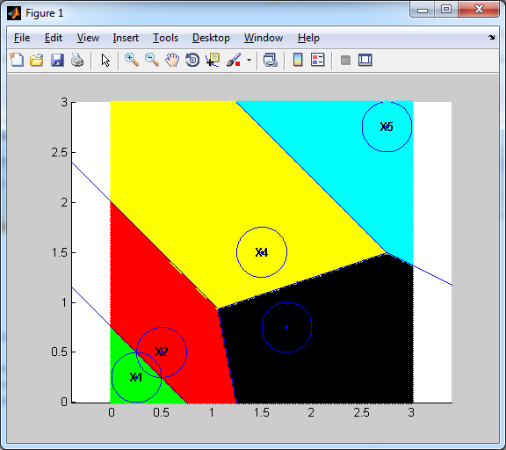
Methods-
Checking Accuracy of Algorithms
Using Matlab's "voronoi" command, we plotted the points' exact Euclidean VT.
We can then check our plot with Matlab's "voronoi" plot.
Image for Matlab's Voronoi command on points (.25,.25), (.50,.50), (1.75,.75) (1.5,1.5), (2.75,2.5).
Both plots on top of each other

Slide 10
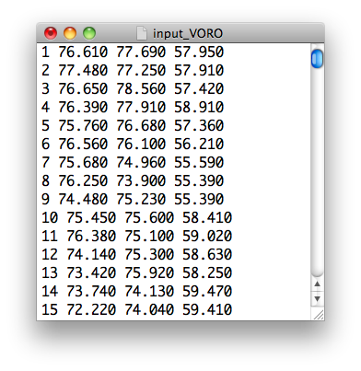
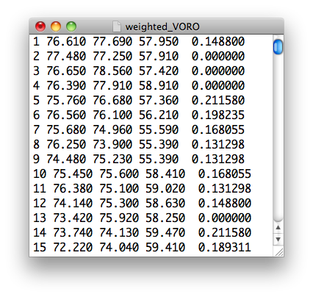
Methods-
VORO++ Script to Attach Weights
Using Python and the VORO++ library, we created a new PDB file with the weights of each molecule attached.

Slide 11
Results- VMD
VMD
  a computer visualization program for large biomolecular systems using 3D graphics and built in scripting.
  Upload the results of weighted VT from Voro ++
  Show lipid shells and interfacial water molecules
Method
  Upload the C2_29 protein onto VMD
  Upload the files POPCHOLSOL_1-9, the lipid shells one by one.
  We do the same for the interfacial water molecules
  The 1st solvent shell is adjacent to the protein/lipid, and 2nd solvent shell is the solvent neighboring the 1st lipid shell ... etc.

Slide 12
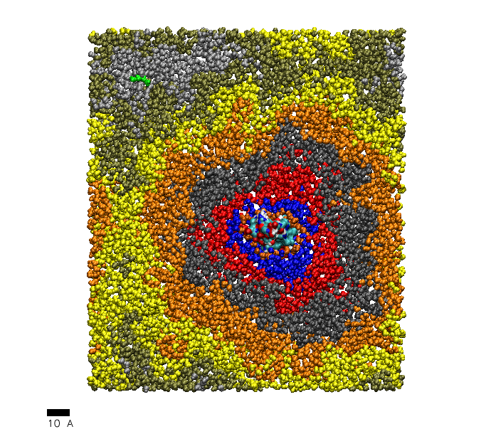
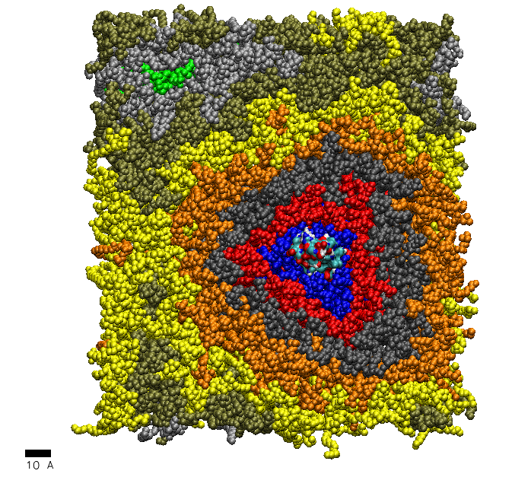
Results- VMD Output
VMD image for the C2_29 protein and its 9 lipid shells
VMD image for the C2_29 protein

Slide 13
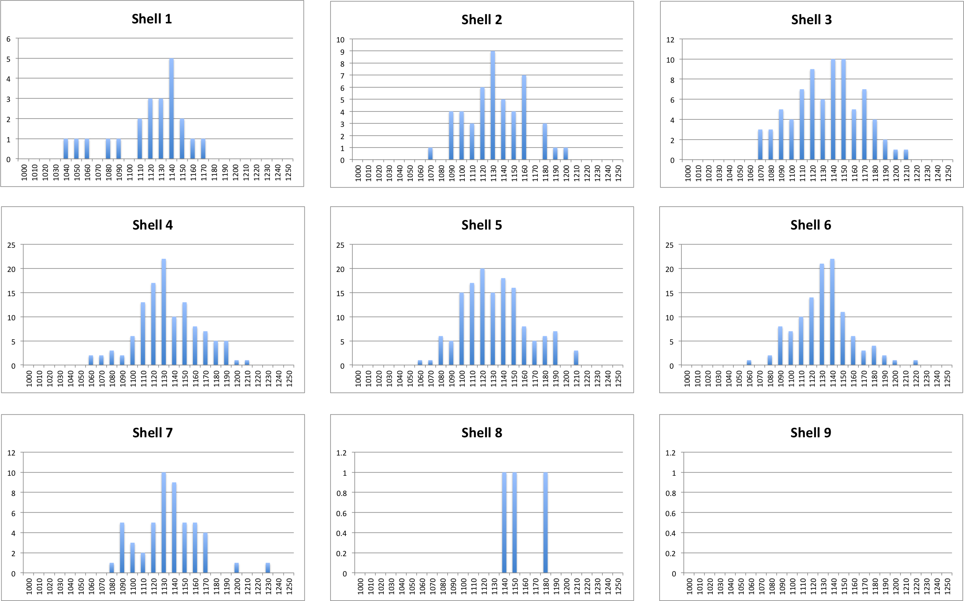
Results - Frequency of Weights
POP Molecules

Slide 14
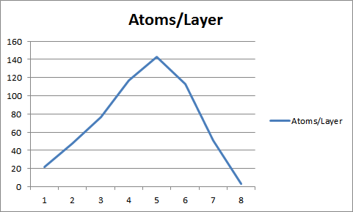
Results - Means and Atom Distribution
POP Molecules

Slide 15
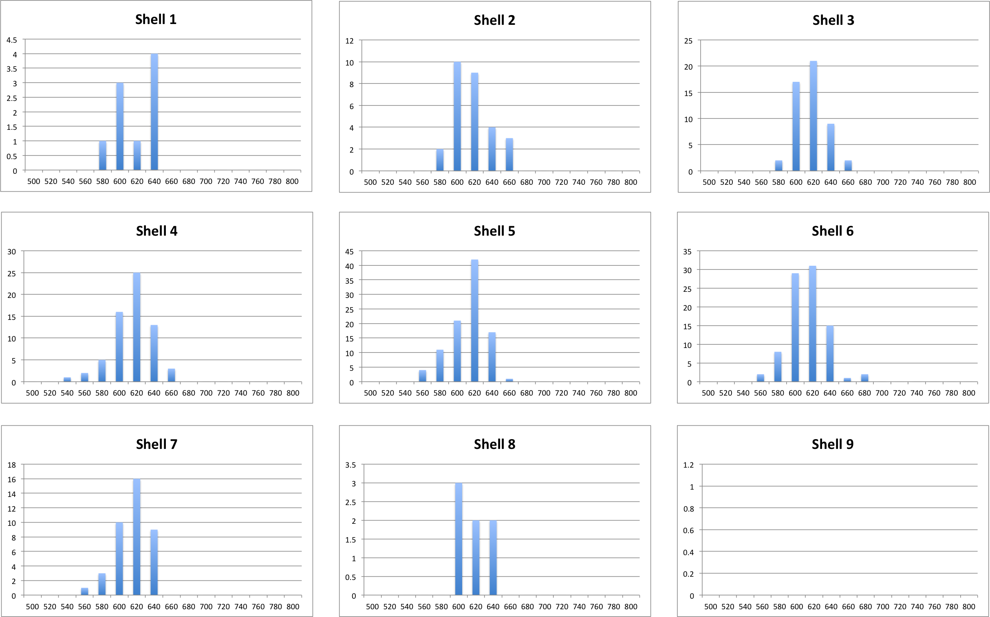
Results - Frequency of Weights
CHO Molecules

Slide 16
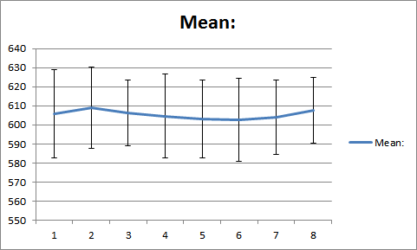
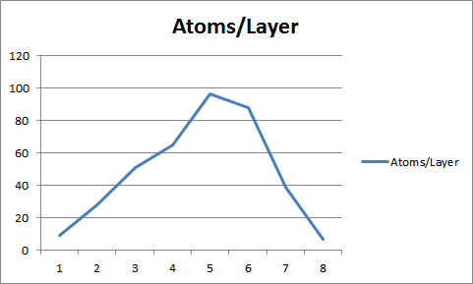
Results - Means and Atom Distribution
CHO Molecules

Slide 17
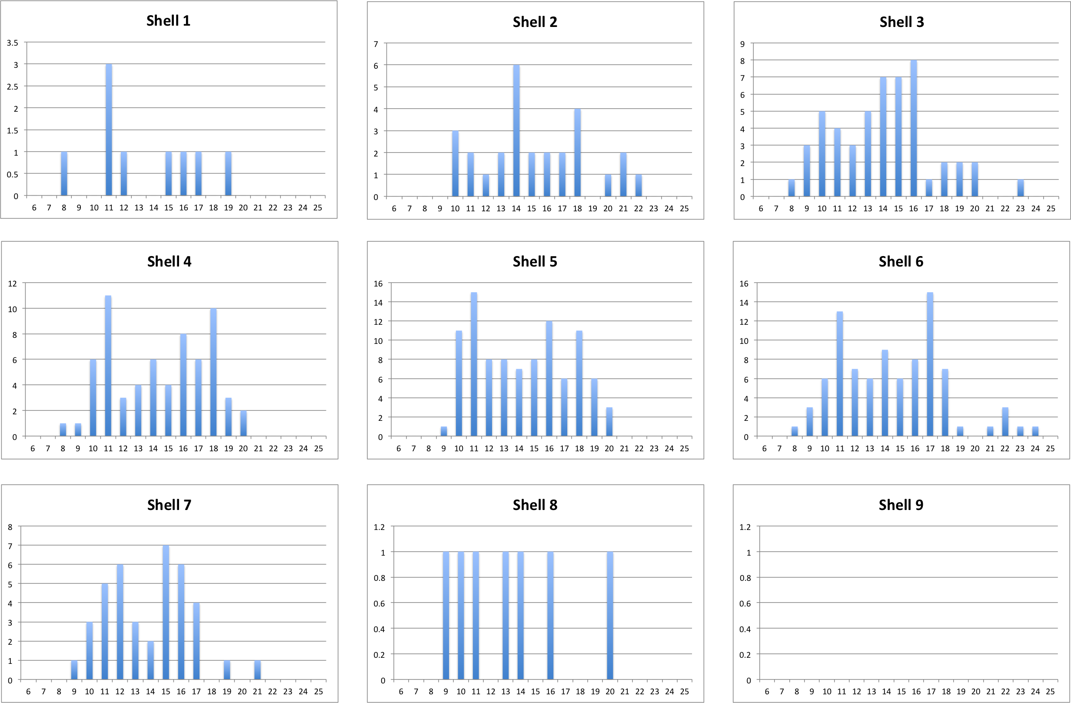
Results - Frequency of Weights
CHO_O6 Molecules

Slide 18
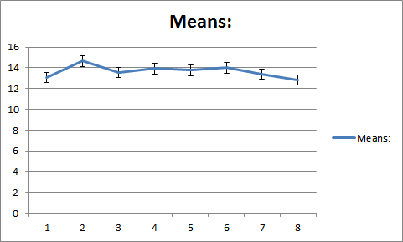
Results - Means and Atom Distribution
CHO_06 Molecules

Slide 19
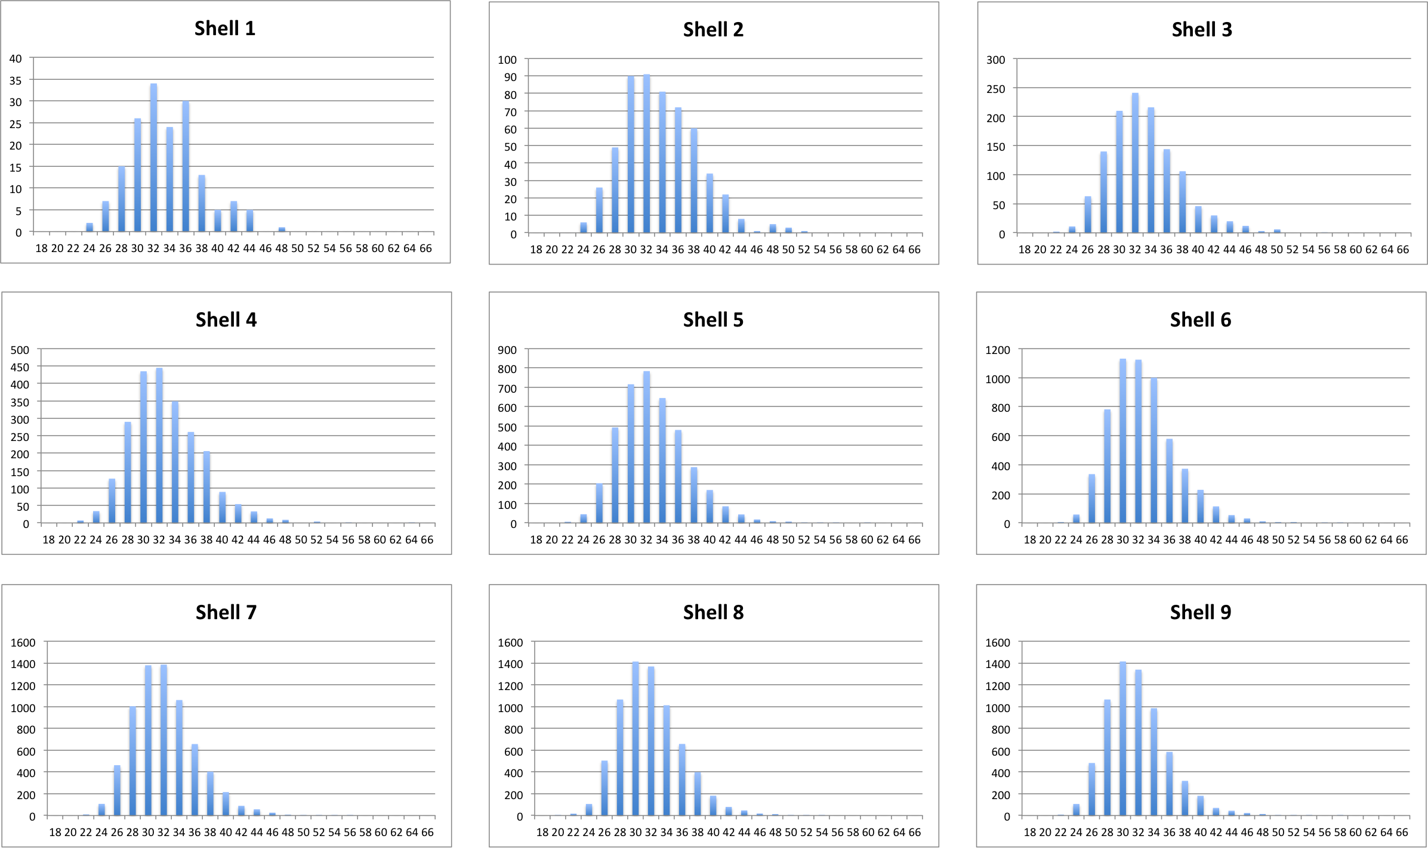
Results - Frequency of Weights
SOL (Solvent) Molecules

Slide 20
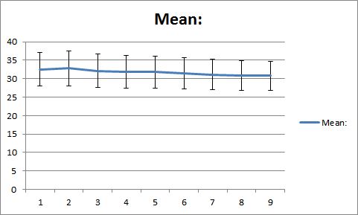
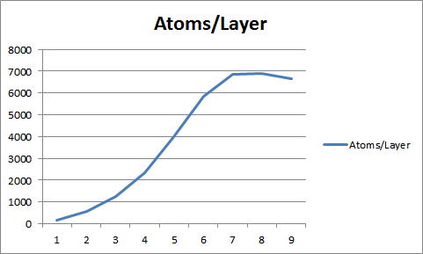
Results - Means and Atom Distribution
SOL Molecules

Slide 21
Results - Voroprot
Voroprot
  A software tool used for constructing and visualizing Voronoi diagrams.
  Can be used to find cavities and pockets in proteins.
  Can we use Voroprot to find void spaces?
"Find buried balls" procedure
  Investigated the meaning of the parameters of the search.
  Minimal buried ball radius should be set to 0 as we want to detect even the smaller void spaces.
  Rolling probe radius determines the size of the probe that explores the cavities.

Slide 22
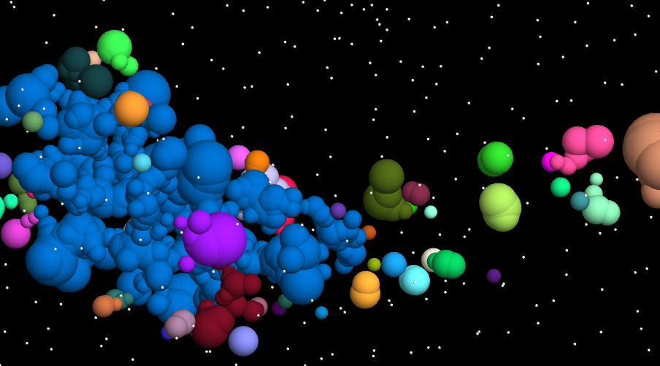
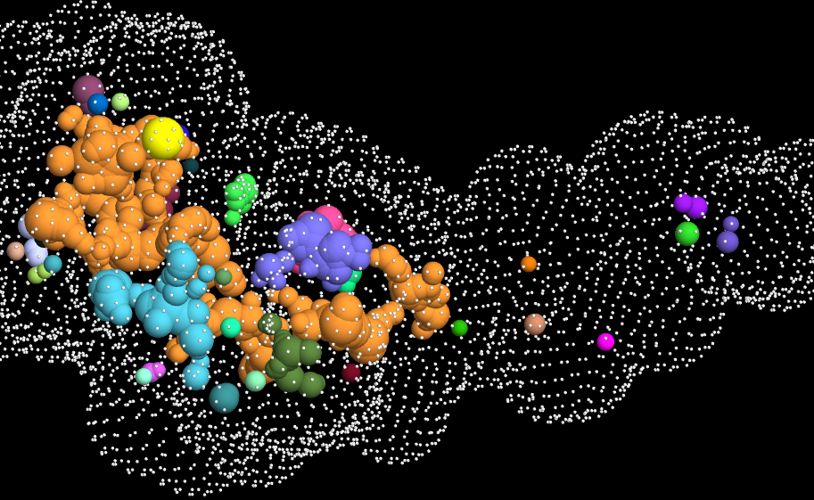
Results - Voroprot
The cavities are not equivalent to void spaces generally, but with the right parameters it should be possible to detect voids.

Slide 23
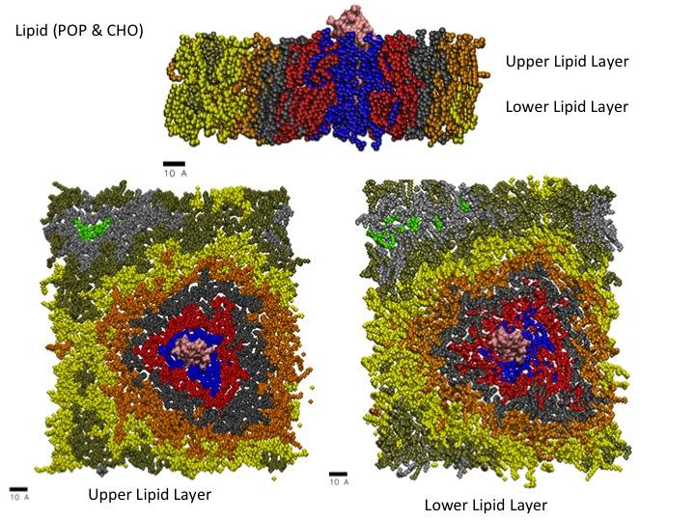
Further Research -
Use weighted PDB for visual analysis
How can we visually analyze the nearest neighbor weights in the shells around the protein?

Slide 24
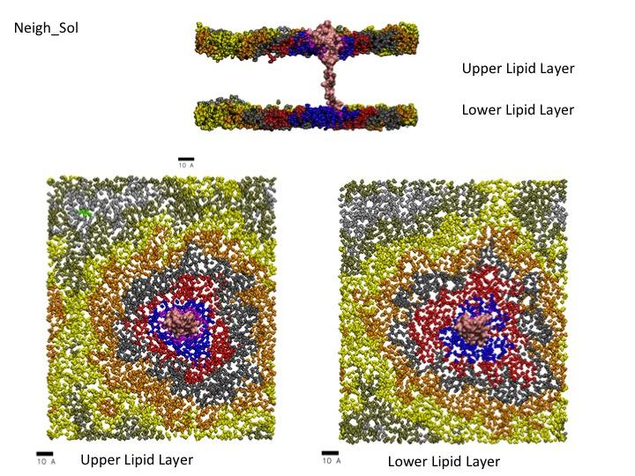
Further Research -
Use weighted PDB for visual analysis
How can we visually analyze the nearest neighbor weights in the shells around the protein?

Slide 25
Further Research -
Use weighted PDB for computational analysis
How can we computationally analyze the nearest neighbor weights in the shells around the protein?
'r' code
analyze weight frequencies, averages and standard deviations of the 9 shells and their nearest neighbors

Slide 26
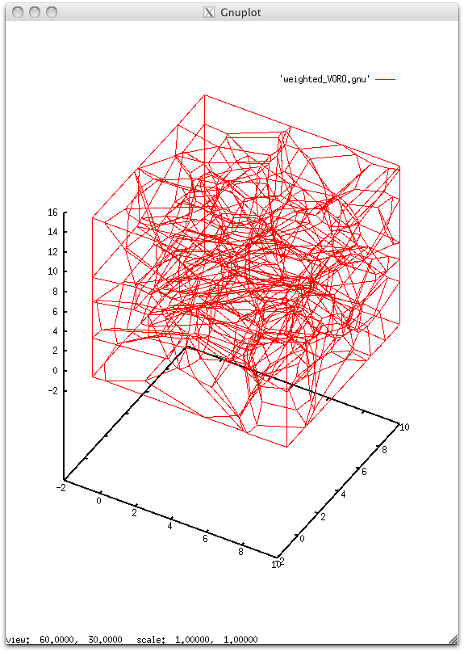
Further Research -
Use VORO++ to compute radical (power) containers
How can we analyze the volume of a container, constructed using VORO++'s power tessellation method?
VORO++ library's radical.cc
sub-section:
x: 1 to 10
y: 1 to 10
z: 1 to 15
number of blocks
x = 5
y = 5
z = 5

Slide 27
Further Research -
Use Voroprot to find void spaces
Use domain-specific knowledge to find the best value for the rolling probe radius.
Investigate how including solvent molecules in the pdb file changes how Voroprot detects cavities.

